Slide 1
Automatic Fight Detection
In Surveillance Videos
Supervised by :
Dr. Heba Ali Elkhobby

Slide 2
Shady Abdelaziz ElGhareb Sakr Abdelrahman Atif Attia Elfiky Abdelrahman Ali Sadik Abdella Moaz Abdeltawab Ali ELzoughby Mohamed Mortada Elasayed Yasser Abdelfatah Ahmed Nasr
Team Members:

Slide 3
TABLE OF CONTENT
Introduction
Computer vision
Implementation
Results
Conclusion

Slide 4
Introduction
Violent behavior in public places is an issue that has to be addressed.
Communities are also eroded by violence, which reduces productivity,lowers property values, and disrupts social services. Across the world, violence is a severe public health issue.
It affects people at various phases of life, from infants to the elderly.
Recognizing violence is challenging since it must be done on real-time videos captured by a large number of surveillance cameras at any time and in any location.

Slide 5
It should be able to make reliable real-time detection and alert corresponding authorities as soon as violent activities occur.
Public video surveillance systems are widespread around the world and can provide accurate and complete information in many security applications.
However, having to watch videos for hours reduces your ability to make quick decisions.

Slide 6
Video surveillance is essential to prevent crime and violence.
This is so that authorities do not have to watch videos for hours to identify events that only last a few seconds.
Recent studies have highlighted the accuracy of deep learning approaches to violence detection.
In this work we will be discussing the implementation of an Automatic Fight Detection in Surveillance Videos system using MobileNetv2.

Slide 7
Problem Statement
● CCTV Surveillance is used to a greater extent but still it lacks the feature of automatic violence detection.
● Manual monitoring is not a feasible task and the time taken to respond to the situation is also crucial.
● A Real-time violence alert system is proposed.

Slide 8
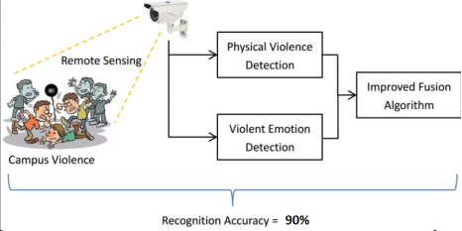
Objectives of the project
The main objective of this system is to detect and localize fight scenes, suspicious behaviors or irregular events in a scene.
The method detects fight regions in a video and it is fast enough for real-time applications.

Slide 9
Technical Background

Slide 10
Computer Vision
Computer vision is the process of using machines to understand and analyze imagery (both photos and videos).
Computer vision is the broad parent name for any computations involving visual content – that means images, videos, icons, and anything else with pixels involved.
But within this parent idea, there are a few specific tasks that are core building blocks:
In object classification, you train a model on a dataset of specific objects, and the model classifies new objects as belonging to one or more of your training categories.
For object identification, your model will recognize a specific instance of an object

Slide 11
Outside of just recognition, other methods of analysis include:
Video motion analysis uses computer vision to estimate the velocity of objects in a video, or the camera itself.
Scene reconstruction creates a 3D model of a scene inputted through images or video.
In image restoration, noise such as blurring is removed from photos using Machine Learning based filters.
Any other application that involves understanding pixels through software can safely be labeled as computer vision.

Slide 12
One of the major open questions in both Neuroscience and Machine Learning is: how exactly do our brains work, and how can we approximate that with our own algorithms?
The reality is that there are very few working and comprehensive theories of brain computation; so despite the fact that Neural Nets are supposed to “mimic the way the brain works,” nobody is quite sure if that’s actually true.
Jeff Hawkins has an entire book on this topic called On Intelligence.

Slide 13
The same paradox holds true for computer vision – since we’re not decided on how the brain and eyes process images, it’s difficult to say how well the algorithms used in production approximate our own internal mental processes.
For example, studies have shown that some functions that we thought happen in the brain of frogs actually take place in the eyes.
We’re a far cry from amphibians, but similar uncertainty exists in human cognition.

Slide 14
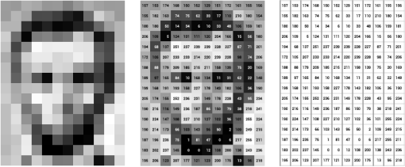
Machines interpret images very simply: as a series of pixels, each with their own set of color values.
Consider the simplified image below,
and how grayscale values
are converted into a
simple array of numbers:

Slide 15
Think of an image as a giant grid of different squares, or pixels (this image is a very simplified version of what looks like either Abraham Lincoln or a Dementor).
Each pixel in an image can be represented by a number, usually from 0 – 255.
The series of numbers on the right is what software sees when you input an image.
For our image, there are 12 columns and 16 rows, which means there are 192 input values for this image.

Slide 16
When we start to add in color, things get more complicated.
Computers usually read color as a series of 3 values – red, green, and blue (RGB) – on that same 0 – 255 scale.
Now, each pixel actually has 3 values for the computer to store in addition to its position.
If we were to colorize President Lincoln (or Harry Potter’s worst fear), that would lead to 12 x 16 x 3 values, or 576 numbers.

Slide 17
For some perspective on how computationally expensive this is,consider this tree:
Each color value is stored in 8 bits.
8 bits x 3 colors per pixel = 24 bits per pixel.
A normal sized 1024 x 768 image x 24 bits per pixel = almost 19M bits, or about 2.36 megabytes.
That’s a lot of memory to require for one image, and a lot of pixels for an algorithm to iterate over.
But to train a model with meaningful accuracy – especially when you’re talking about Deep Learning – you’d usually need tens of thousands of images, and the more the merrier.

Slide 18
Computer vision and convolutional neural networks
Much of the progress made in computer vision accuracy over the past few years is due in part to a special type of algorithm.
Convolutional Neural Networks are a subset of Deep Learning with a few extra added operations, and they’ve been shown to achieve impressive accuracy on image-associated tasks.
Convolutional Neural Networks (CNNs or ConvNets) utilize the same major concepts of Neural Networks, but add in some steps before the normal architecture.

Slide 19
CNN Processes
Convolution
During the convolution process (perhaps why it’s called a CNN) the input image pixels are modified by a filter.
This is just a matrix (smaller than the original pixel matrix) that we multiply different pieces of the input image by the output – often called a Feature Map will usually be smaller than the original image, and theoretically be more informative.

Slide 20
ReLU
This futuristic sounding acronym stands for Rectified Linear Unit, which is an easy function to introduce non-linearity into the feature map.
All negative values are simply changed to zero, removing all black from the image.
The formal function is y = max(0, x).

Slide 21
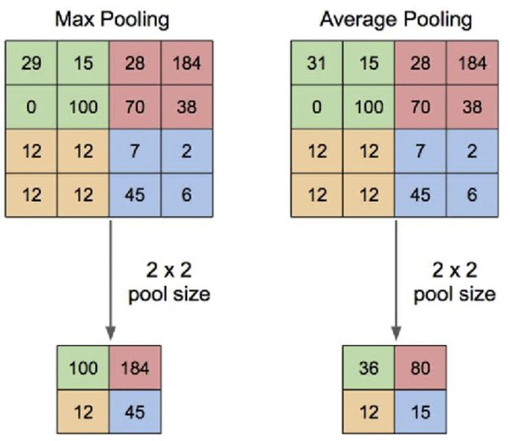
Pooling
In pooling, the image is scanned over by a set width of pixels, and either the max, sum, or average of those pixels is taken as a representation of that portion of the image.
This process further reduces the size of the feature map(s) by a factor of whatever size is pooled.

Slide 22
Computer Vision Hierarchy
Computer vision is divided into three basic categories as follows:
● Low-level vision: It includes process images for feature Extraction.
● Intermediate-level vision: It includes object recognition and 3D scene interpretation
● High-level vision: It includes conceptual description of a scene like activity, intention and behavior.

Slide 23
Computer Vision Vs Image Processing
Image processing studies image to image transformation.
The input and output of image processing are both images.
Computer vision is the construction of explicit, meaningful descriptions of physical objects from their image.
The output of computer vision is a description or an interpretation of structures in a 3D scene.

Slide 24
PROJECT IMPLEMENTATION

Slide 25
Method
The method described here is based on the principle that when a fight occurs in the Surveillance Videos, the fighting frames of video will be significantly different than the Non-fighting frames.
We train a model that consists of a feature extractor and learns the temporal patterns of the input volume of frames.
The model is trained with video volumes consisting of normal and fighting scenes.
Footage from the surveillance camera is broken down into frames.

Slide 26
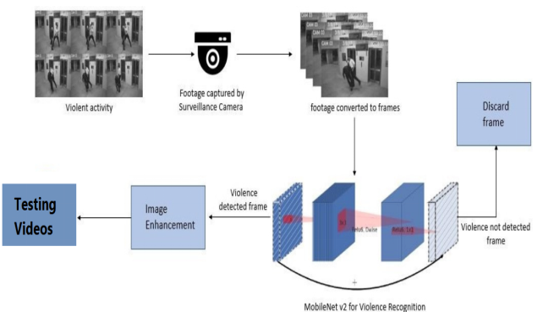
The frames are given as input to
MobileNet v2 classifier for detecting
violent activities in the given sequence
of input frames.
If no violent activity is recognized
the respective frames are discarded. The
violence detected frame is obtainedand
it is enhanced for better clarity
Method

Slide 27
Dataset
The dataset contains 3500 video clips which belong to two classes, violence and non-violence respectively.
The average duration of the video clips is 5 seconds and majority of those videos are from CCTV footage.
For training, 1750 videos each from the violent and non-violent classes are taken at each epoch.

Slide 28
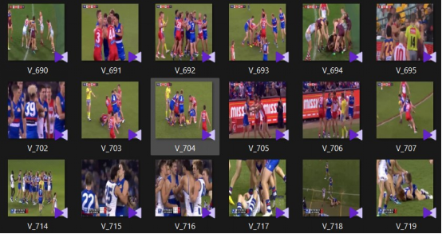
To test our methodology, we work with these three datasets,Hockey Fight Dataset , Movies Dataset and Violent Flows .
the 3 datasets captured from closed- circuited-TV,Phone or high-resolution recorder, the quality, number of pixels and length varies between dataset.

Slide 29
Hockey Fights :
Dataset composed of equal numbers of violence and nonviolence action during hockey professional matches, usually Two players participating in close body interaction.
Real Life Violence Dataset :
This is a crowd violence dataset.
Most of the crowd violence seen in this dataset are random clips

Slide 30
Movies :
This dataset consists of fight sequences collected from movies, for the non-violence label - videos of general action activity gathered from movies.
The dataset is made up of an equal number of violent movie clips and non-violent movie clips.
Unlike the Hockey dataset, this dataset varies profoundly between samples.

Slide 31
Pre-Processing
The pre-processing step includes importing the video frames and making it ready for training.
It also involves feature extraction which is the input to the training algorithm.
Initially the video is converted to frames.
Each video will generate a set of frames which approximately denotes the number of seconds.

Slide 32
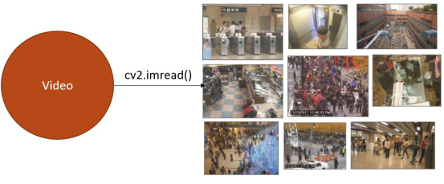
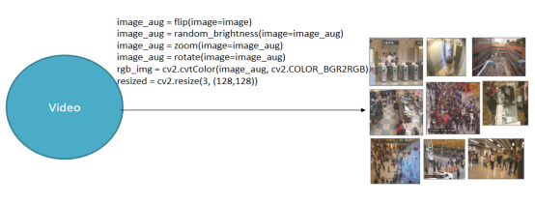
This process of converting video to
frame using python libraries is
illustrated in the Figure .

Slide 33
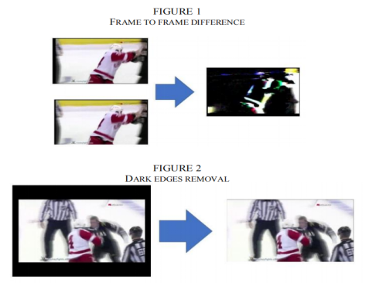
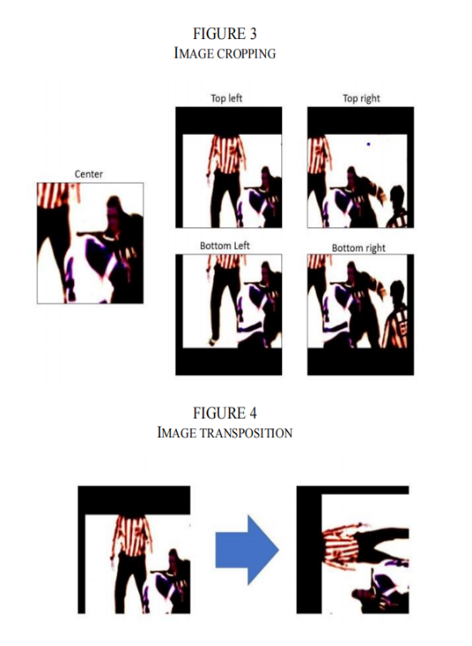
The task of this stage is to convert raw data to an acceptable input for the model. Each frame is extracted from the raw videos are modified by rotating , flipping , zooming and random brightness

Slide 34
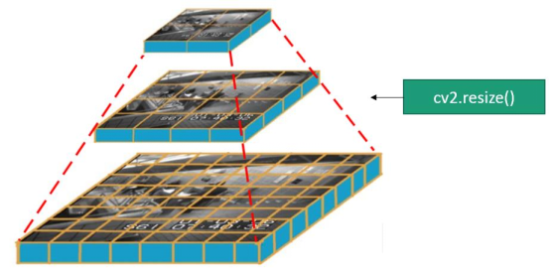
.
and resized to 128*128 To ensure that the input images are all on the same scale, the pixel values are scaled between 0 and 1 for normalization
Now the input is ready
for model training.

Slide 35
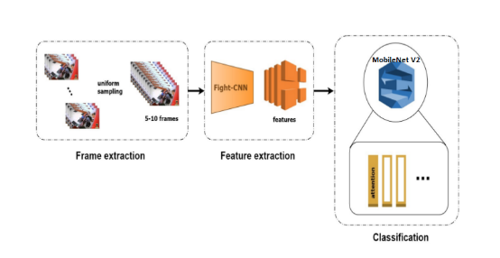
Training
The features extracted in the data pre-processing step are used as an initial input to the training algorithm.
We will use MobileNet v2 to make our model , Adam optimization algorithm and Binary_Crossentropy loss .
We use One Cycle Learning
Rate with initial learning rate
of 0.00001, with maximum
learning rate of .0001 and
learning rate decay rate of 0.8
per epoch . We use a batch size of 16.

Slide 36
MobileNet v2
Since the images can be seen as a matrix of pixels and each pixel describes some features of the image, these technologies use filters to filter out a certain set of pixels in the images and results in the formation of output predictions about images.
CNN uses a lot of pre-defined and stored filters and does a convolution (X) of that filter with the pixel matrix of the image.

Slide 37
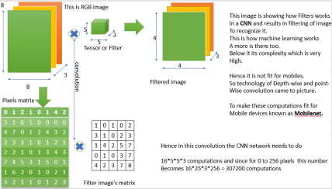
MobileNet v2 This results in filtering the image’s objects and comparing them with a large set of predefined objects to identify a match between them. Hence in this way these models are able to predict the image.

Slide 38
MobileNet v2
But these technologies require a high GPU to increase the comparison rate between millions of data which cannot be provided by any mobile device.Hence, here comes in action what is known as MobileNet.
Mobilenet is a model which does the same convolution as done by CNN to filter images but in a different way than those done by the previous CNN.
It uses the idea of Depth convolution and point convolution which is different from the normal convolution as done by normal CNNs.
This increases the efficiency of CNN to predict images and hence they can be able to compete in the mobile systems as well.

Slide 39
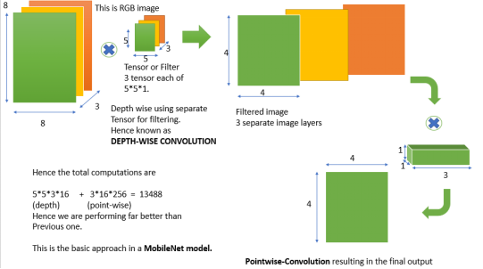
MobileNet v2
Since these ways of convolution reduce the comparison and recognition time a lot, it provides a better response in a very short time and hence we are using them as our image recognition model.

Slide 40
The main strategies introduced in MobileNetV2 were linear bottleneck and inverted residual blocks.
In the linear bottleneck layer, the channel dimension of input is expanded to reduce the risk of information loss by nonlinear functions such as ReLU.
It comes from the fact that information lost in some channels might be preserved in other channels.
The inverted residual block has a ("narrow" -"wide"-""narrow") structure in the channel dimension.

Slide 41
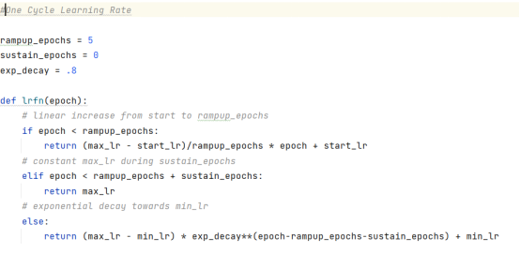
One Cycle Learning Rate Code

Slide 42
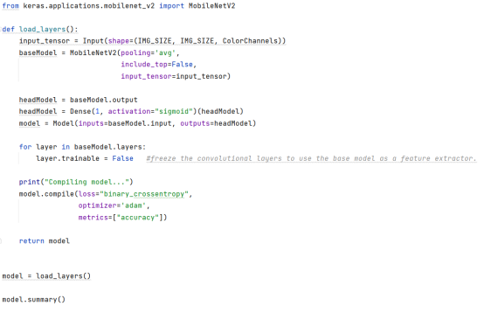
MobileNet v2 Training Code

Slide 43
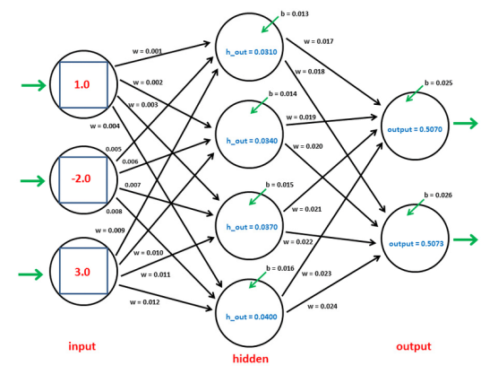
Optimization for training
Optimizers are algorithms or methods used to change the attributes of your neural network such as weights and learning rate in order to reduce the losses.

Slide 44
the “Adam” Optimizer :
Adaptive Moment Estimation is an algorithm for optimization technique for gradient descent.
The method is really efficient when working with large problems involving a lot of data or parameters.
It requires less memory and is efficient. Intuitively, it is a combination of the ‘gradient descent with momentum’ algorithm and the ‘RMSP’ algorithm.
Adam optimizer involves a combination of two gradient descent methodologies:
Momentum
Root Mean Square Propagation (RMSP)

Slide 45
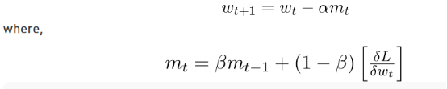
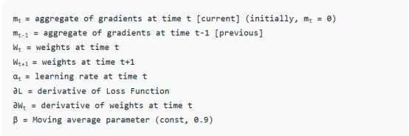
Momentum
This algorithm is used to accelerate the gradient descent algorithm by taking into consideration the ‘exponentially weighted average’ of the gradients.

Slide 46
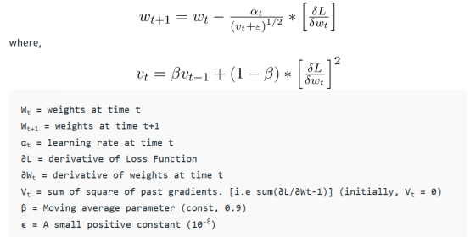
Root Mean Square Propagation (RMSP):
Root mean square prop or RMSprop is an adaptive learning algorithm that tries to improve performance on problems with gradients (e.g. natural language and computer vision problems).

Slide 47
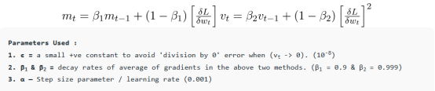
Mathematical aspect of Adam optimizer
Taking the formulas used in the above two methods, we get
Since mt and vt have both initialized as 0 (based on the above methods), it is observed that they gain a tendency to be ‘biased towards 0’ as both β1 & β2 ≈ 1.
This Optimizer fixes this problem by computing ‘bias-corrected’ mt and vt.

Slide 48
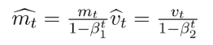
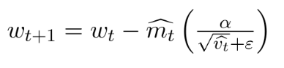
This is also done to control the weights while reaching the global minimum to prevent high oscillations when near it.
The formulas used are:
We are adapting to the gradient descent after every iteration so that it remains controlled and unbiased throughout the process, hence the name Adam.
Now, instead of our normal weight parameters mt and vt , we take the bias-corrected weight parameters (m_hat)t and (v_hat)t.
Putting them into our general equation, we get:

Slide 49
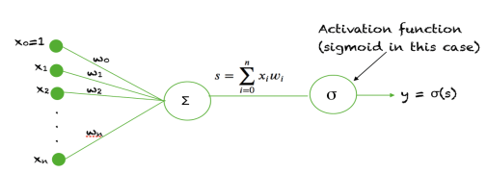
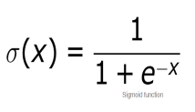
Activation function :
We use Sigmoid Function and it is a special form of the logistic function and is usually denoted by:

Slide 50
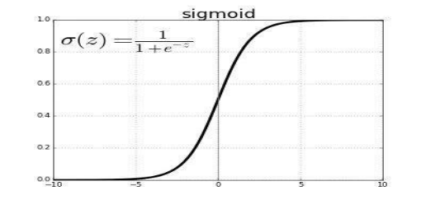
When the activation function for a neuron is a sigmoid function it is a guarantee that the output of this unit will always be between 0 and 1.
Also, as the sigmoid is
a nonlinear function,
the output of this unit
would be a nonlinear
function of the weighted
sum of inputs.

Slide 51
PROJECT RESULTS

Slide 52
we now display the training and testing accuracy and loss for the MobileNet v2 model when a dataset containing 3500 videos of average duration 5 seconds is given as input.
We used 50 epochs , For each epoch 1750 videos from the fight class and 1750 videos from the non-fight are trained , the accuracy and loss comes to a constant level of increment and decrement after approximately 8 epochs.
90% accuracy was obtained on training.

Slide 53
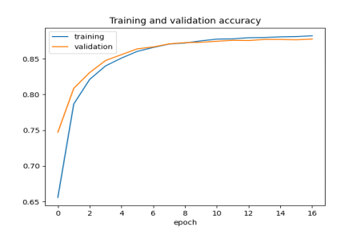
In this section testing and training accuracy are displayed in the below given graphical representation.

Slide 54
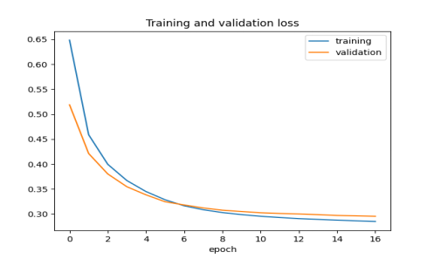
In this section testing and training validation loss are displayed in the below given graphical representation.

Slide 55
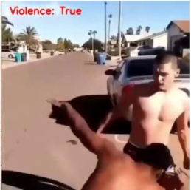
For the output : A video with violence is
given as input to the system.
It shows one frame in the video that was
labeled to have violent activity.

Slide 56
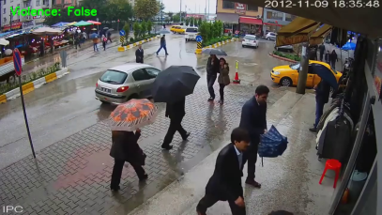
Another video clip without
violent activity was given as input.
It shows one frame of that
video which is rightly labeled
as false or non-violence.

Slide 57
PROJECT CONCLUSION

Slide 58
PROJECT CONCLUSION
Violence scene detection in real-time is a challenging problem due to the diverse content and large variations in quality.
In this research, we use the MobileNet v2 model to offer an innovative and efficient technique for identifying violent events in real-time surveillance footage.
The proposed network has a good recognition accuracy in typical benchmark datasets, indicating that it can learn discriminative motion saliency maps successfully.
It’s also computationally efficient, making it ideal for use on low-end devices.

Slide 59
Future scope
This model could be upgraded to work in multiple cameras connected by a single network in a concurrent fashion.
A short video of the violent activity could be incorporated along with the alert message.

Slide 60
THE END

